Slide 1
CS 242/608Algorithms
Week 4 Dr. Tom Schmidt

Slide 2
Week 4 Agenda
A Puzzle
El Quiz
Probability
Indicator Random Variables
Radix Sort
Homework
Wrap-up and review

Slide 3
Today’s puzzle
How far can you reach with a stack of n blocks, each 2 units long?
d(n)

Slide 4
Today’s puzzle
How far can you reach with a stack of n blocks, each 2 units long?
d(n) = 1+ 1/2 + 1/3 + 1/4 + 1/5 + 1/6 …
1
nth harmonic number, Hn = Θ(lg n)
1/2
1/3
1/4
1/5
1/6
d(n)

Slide 5
Google Interview
A member of Teams Hamburg and Goethe

Slide 6
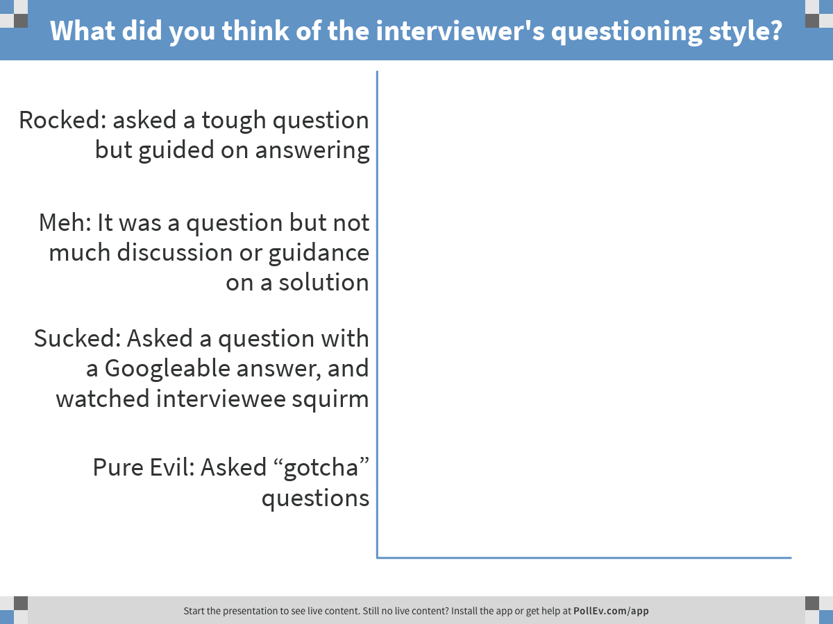
Notes:
What did you think of the interviewer's questioning style?
https://www.polleverywhere.com/multiple_choice_polls/gXPkEw1cpnly2ho

Slide 7
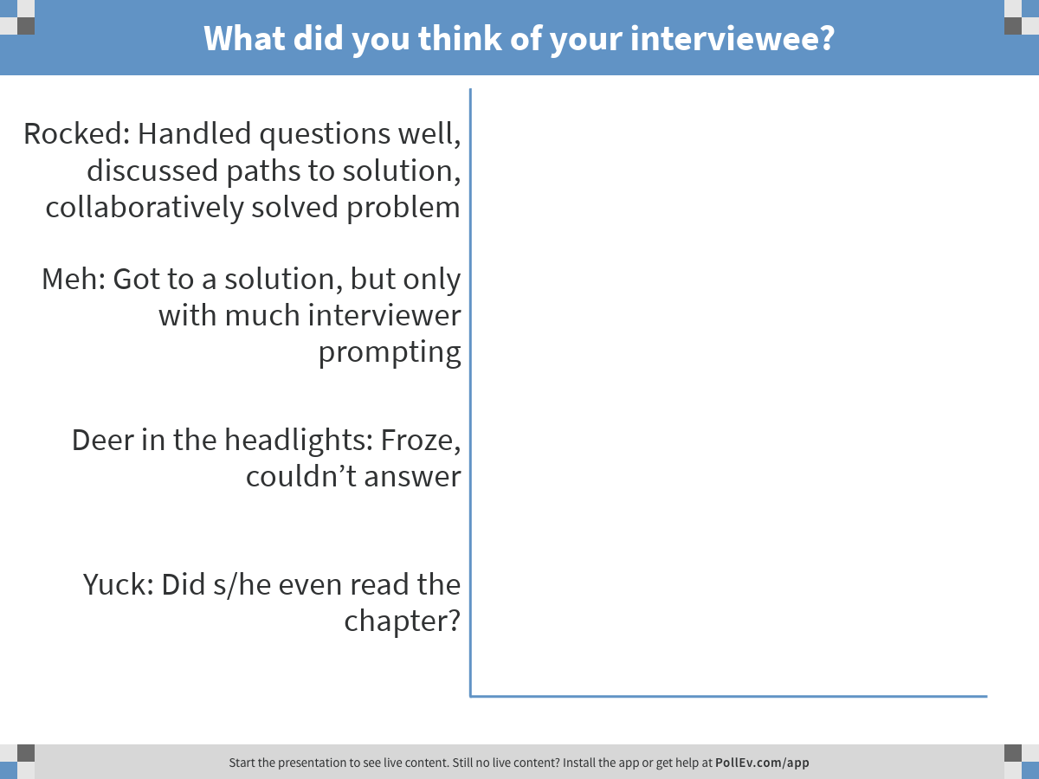
Notes:
What did you think of your interviewee?
https://www.polleverywhere.com/multiple_choice_polls/2Bcwzs8oRbfzQ4C

Slide 8
El Quiz
1) Build a heap by inserting the following values: 22, 37, 31, 41, 33, 27, 8, 5, 22, 31. Show each addition where it goes, and then the resulting heap after re-heap (you do not need to show intermediate steps in re-heaping).
2) Answer two of these three
A) What is the probability that you will roll a 7 or an 11 when shooting craps? Combined, that is: what is your chance of winning on the first roll?
B) What is the actual running time of Radix Sort when sorting 2^20 (about 1MM) numbers in the range 0..2^20? What is the actual running time of Heap Sort for the same input? (you must estimate the number of ops)
Describe the hiring problem. How does randomization assist with a fair solution of it?

Slide 9
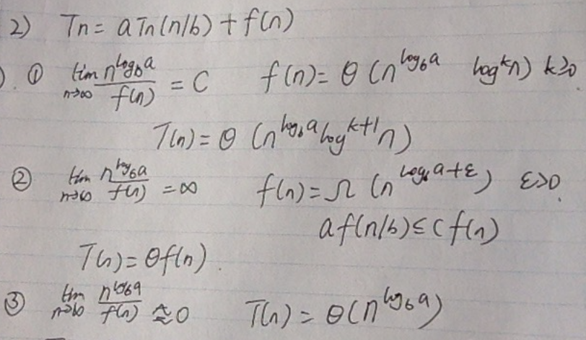
Alternative Master Method Method

Slide 10
Probability
Conditional Probability (note: I’m not good at probability)
Indicator Random Variables

Slide 11
Finite Probability Distribution
A (finite) probability distribution D is a finite “sample space” S of elements or “samples”, where each sample x in S has a non-negative real weight or probability p(x)
The weights must satisfy:
0.17
0.13
Σ p(x) = 1
0.1
0.11
0.2
0
x ∈ S
0.1
0.06
0.13
Sample space
weight or probability of x
D(x) = p(x) = 0.1

Slide 12
Events
Any set E ⊆ S is called an event
Σ p(x)
Pr_{D}[E] =
S
x ∈ E
0.17
0
0.1
0.13
Pr_{D}[E] = 0.4

Slide 13
Conditional Probability
The probability of event A given event B is written Pr[ A | B ]
and is defined to be =
Pr [ A ∩ B ]
Pr [ B ]
S
proportion of A ∩ B
B
A
to B

Slide 14
Conditional Probability
The probability of event A given event B is written Pr[ A | B ]
and is defined to be =
Pr [ A ∩ B ]
Pr [ B ]
A and B are independent events if
Pr[ A | B ] = Pr[ A ]
⇔ Pr[ A ∩ B ] = Pr[ A ] Pr[ B ]
⇔ Pr[ B | A ] = Pr[ B ]

Slide 15
Conditional Probability
Example: On the roll of two independent dice, what is the probability of a total of 8?
S = {(1,1), (1,2), … , (6,6)}
|S| = 36
A = {(2,6), (3,5), (4,4), (5,3), (6,2)}
Pr{A} = 5/36

Slide 16
Conditional Probability
Example: On the roll of two independent dice, if at least one face is known to be an even number, what is the probability of a total of 8?
One die is even, sum is 8 ⇒ Second die is also even.
No. of elementary events in the original sample space: 36
The fact that one face is even, precludes outcomes where both faces are odd.

Slide 17
Conditional Probability
Example: On the roll of two independent dice, if at least one face is known to be an even number, what is the probability of a total of 8?
Hence, sample space size is reduced to 27 (9 elementary events have both odd faces).
Number of elementary events in the reduced sample space that are successes : 3 --{(2,6), (4,4), (6,2)}
Hence, Probability is 3/27 = 1/9.

Slide 18
Conditional Probability
Formalizes the notion of having prior partial knowledge of the outcome of an experiment.
The conditional probability of an event A given that another event B occurs is defined to be
In the previous example
A: Event that sum on the faces is 8.
B: Event that one of them is even.
Pr{B} = 27/36
Pr{A∩B} = 3/36
Pr{A|B} = Pr {A∩B}/Pr{B} = 3/27 = 1/9.

Slide 19
If I randomly put 100 letters into 100 addressed envelopes, on average how many letters will end up in their correct envelopes?
Hmm…
∑_{k} k Pr(k letters end up in correct envelopes)
= ∑_{k} k (…aargh!!…)

Slide 20
On average, in class of size m, how many pairs of people will have the same birthday?
∑_{k} k Pr(exactly k collisions)
= ∑_{k} k (…aargh!!!!…)
Notes:
Did Pr(…) before for k=0, but gets more complicated for larger k. e.g., if 3 people on same day, then have 3 pairs but only 3 people involved.

Slide 21
Random Variable
Let S be sample space in a probability distribution
A Random Variable is a real-valued function on S
S
Sample space


Slide 22
Tossing a Fair Coin n Times
S = all sequences of {H, T}^{n}
D = uniform distribution on S
⇒ D(x) = (½)^{n} for all x 2 S
Random Variables (say n = 10)
X = # of heads
X(HHHTTHTHTT) = 5
Y = (1 if #heads = #tails, 0 otherwise)
Y(HHHTTHTHTT) = 1, Y(THHHHTTTTT) = 0

Slide 23
Notational Conventions
Use letters like A, B, E for events
Use letters like X, Y, f, g for R.V.’s
R.V. = random variable

Slide 24
Two Views of Random Variables
Input to the function is random
Think of a R.V. as
A function from S to the reals 
Or think of the induced distribution on 
Randomness is “pushed” to the values of the function

Slide 25
Two Coins Tossed
X: {TT, TH, HT, HH} → {0, 1, 2} counts the number of heads
Distribution on the
reals
S
HH
2
¼
¼
TT
¼
0
TH
¼
¼
1
HT
½
¼

Slide 26
It’s a Floor Wax And a Dessert Topping
It’s a function on the sample space S
It’s a variable with a probability distribution on its values
You should be comfortable with both views

Slide 27
Indicator Random Variables
Here

Slide 28
Quickly Through Quicksort
The Most Important Sorting Algorithm?

Slide 29
Google Interview
A member of Teams Brandenburg and Neuschwanstein

Slide 30
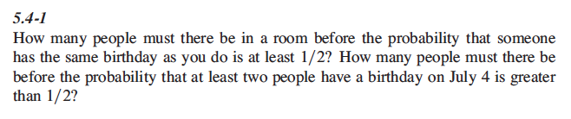
Exercise 5.4-1: Team Hamburg

Slide 31
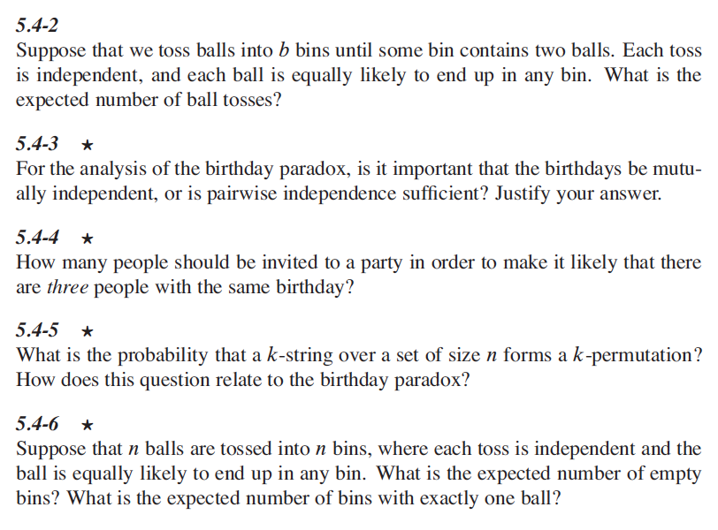
Exercise 5.4-2: Team Goethe

Slide 32

Exercise 7.42: Team BMW

Slide 33
Wrap-up and review
Is the homework getting harder, or easier?
How, generally, are you feeling about the course?
Thank you and تصبح على خير (tusbih ealaa khayr)

